Slide 1
GardenSewa
Garden and Landscaping Services

Slide 2
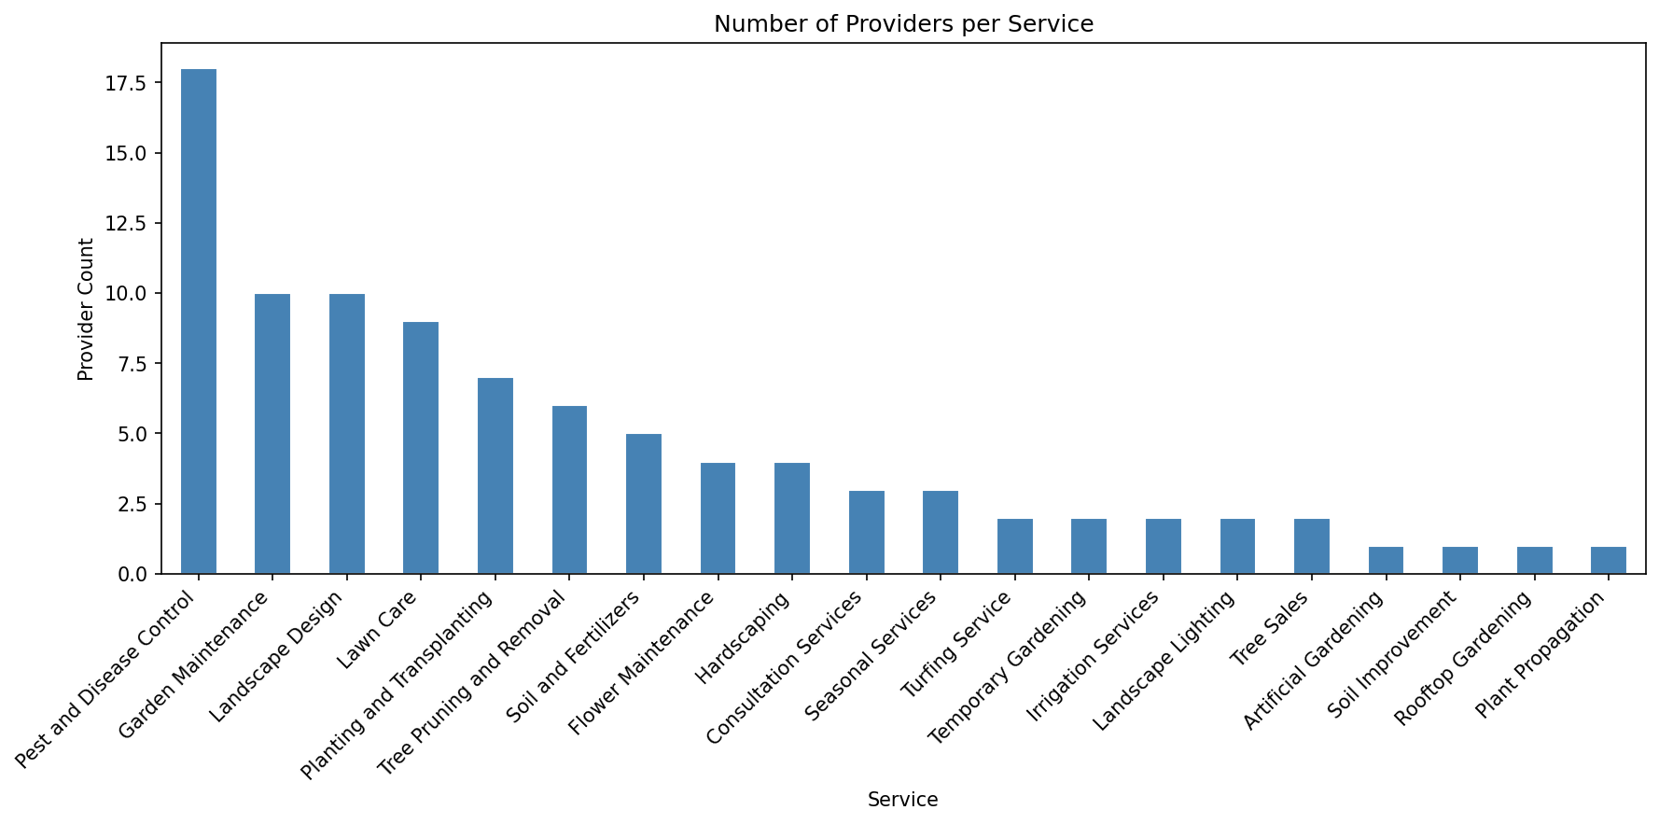
Number of Providers per Service
Description: This chart shows how many providers offer each of GardenSewa’s 20 garden and landscaping services
Insight: Pest and Disease Control is by far the most saturated service, while several niche services have only a single provider each.

Slide 3
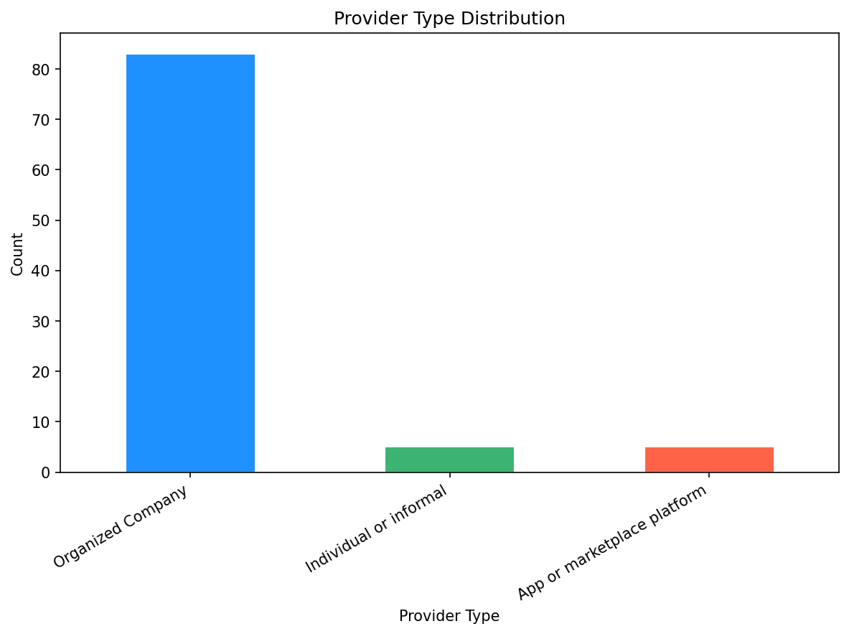
Provider Type Distribution
Description: This chart shows the overall split of listings by provider type: organized company, individual/informal, app/marketplace platform.
Insight: The market is overwhelmingly formalized, with organized companies making up nearly 90% of all listings.

Slide 4
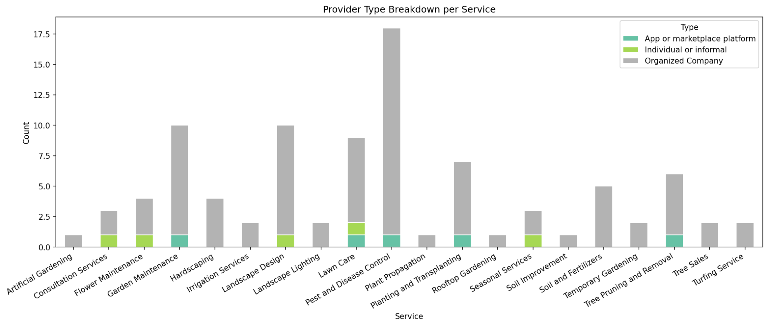
Provider Type Breakdown per Service
Description: This chart breaks down, service by service, which provider type is active in each category.
Insight: Organized companies dominate every service, while app-based platforms appear in only a handful of high-frequency categories.

Slide 5
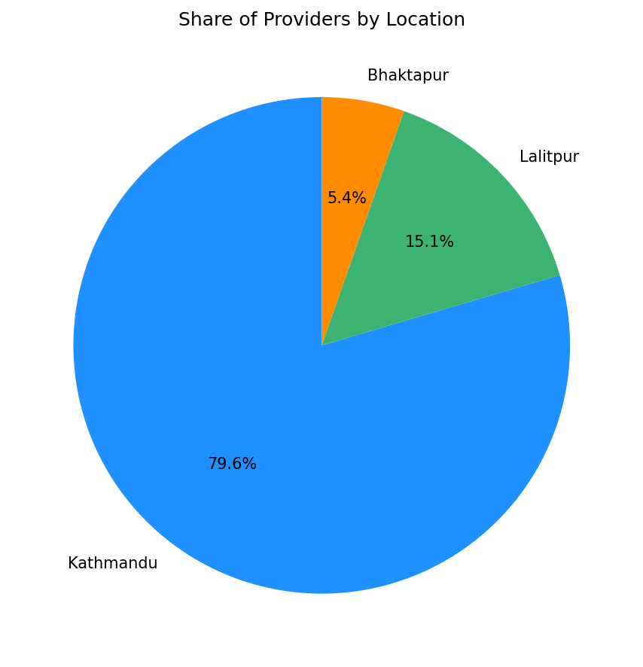
Share of Providers by Location
Description: This chart shows how service listings are distributed across Kathmandu, Lalitpur, and Bhaktapur.
Insight: Service availability is heavily concentrated in Kathmandu, leaving Bhaktapur significantly undeserved.

Slide 6
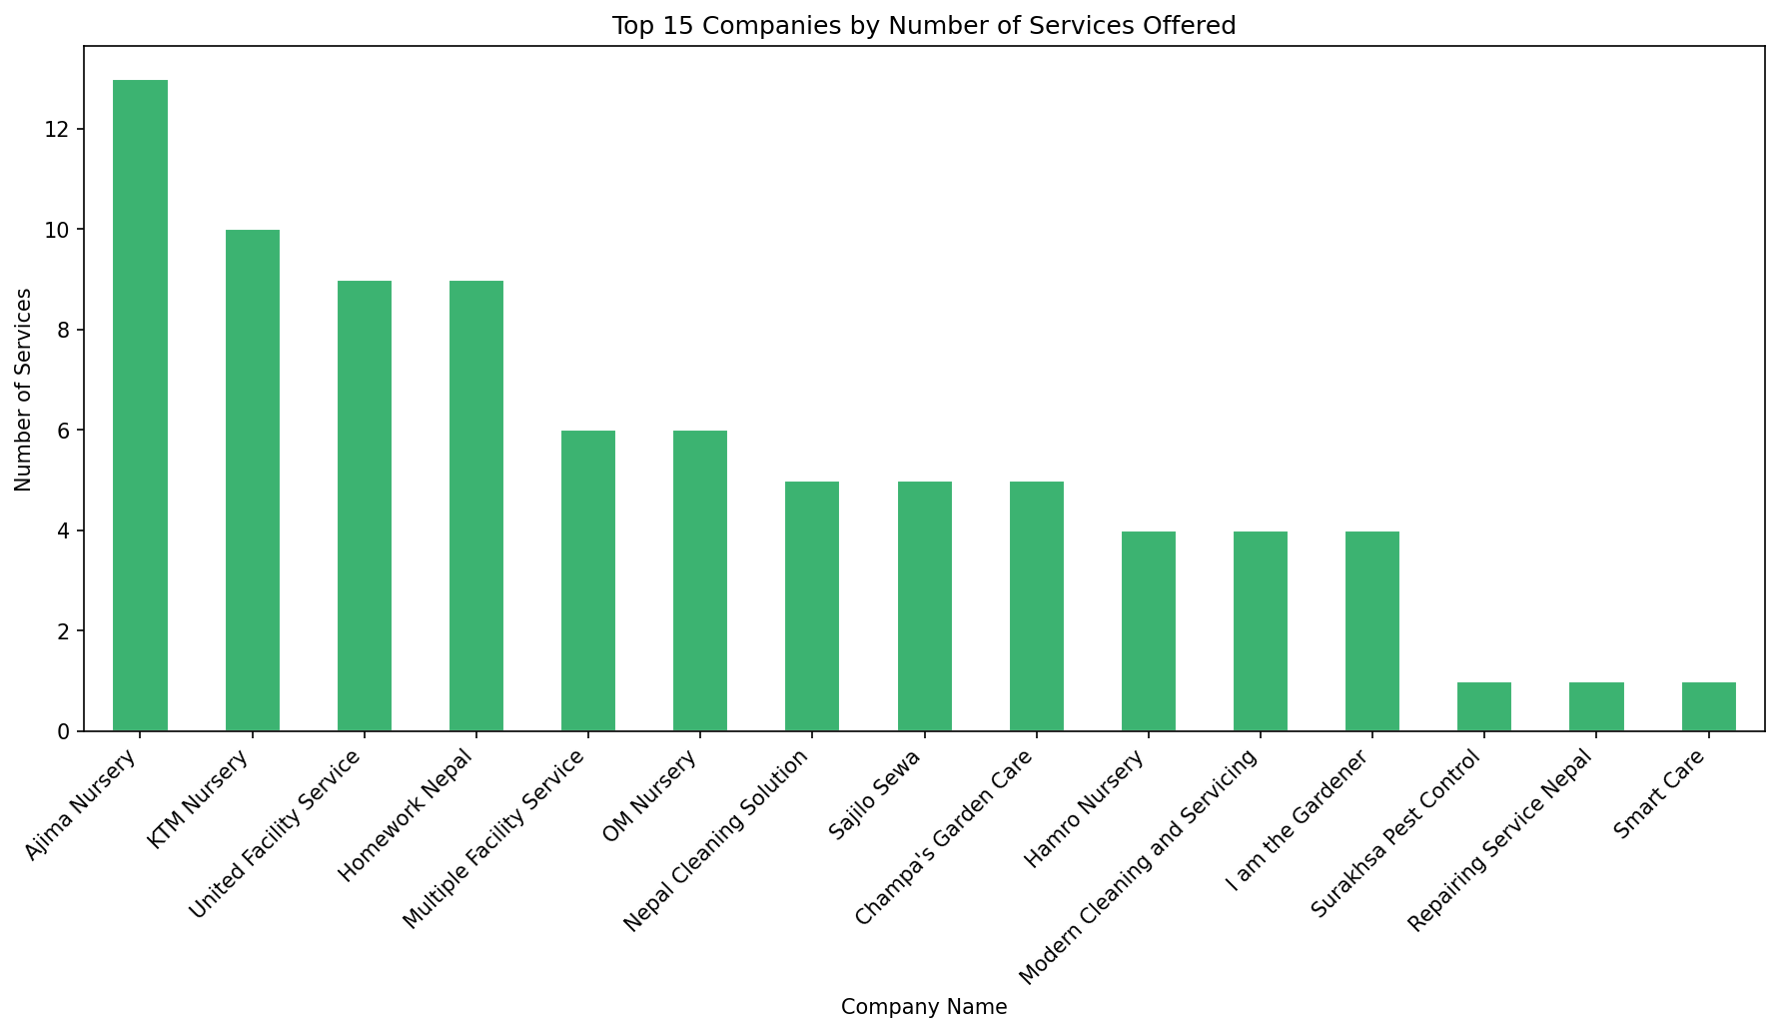
Top 15 Companies by Number of Services Offered
Description: This chart ranks the top 15 companies by how many distinct services they offer.
Insight: Companies like Ajima and KTM Nursery leads, while many companies offer just one service.

Slide 7
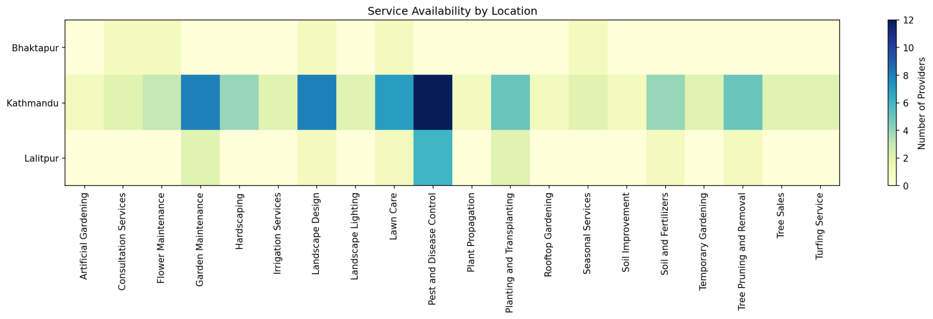
Service Availability by Location
Description: This chart cross-tabulates service category against location to show which services are available where.
Insight: Kathmandu leads in nearly every service category, while Bhaktapur has no presence in the top-demand services.

Slide 8
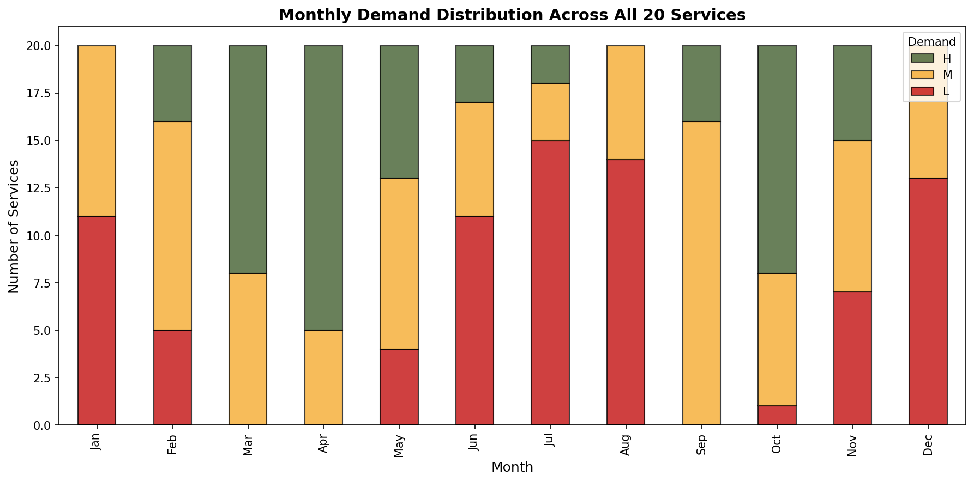
Monthly Demand Distribution Across All 20 Services
Description: This chart tracks how many services are rated High, Moderate, or Low demand in each month of the year.
Insight: Demand peaks sharply in April, while winter and peak monsoon months see almost no high-demand services.

Slide 9
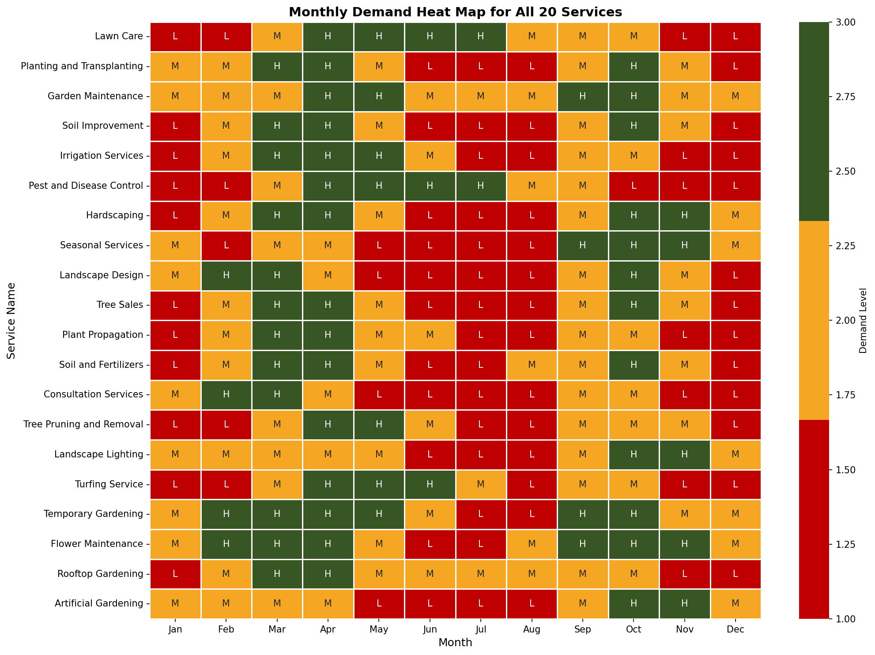
Monthly Demand Heat Map for All 20 Services
Description: This heat map shows the demand level of all 20 services across every month of the year.
Insight: Most services follow a shared seasonal rhythm, though a few like Seasonal Services peak around festival months instead.

Slide 10
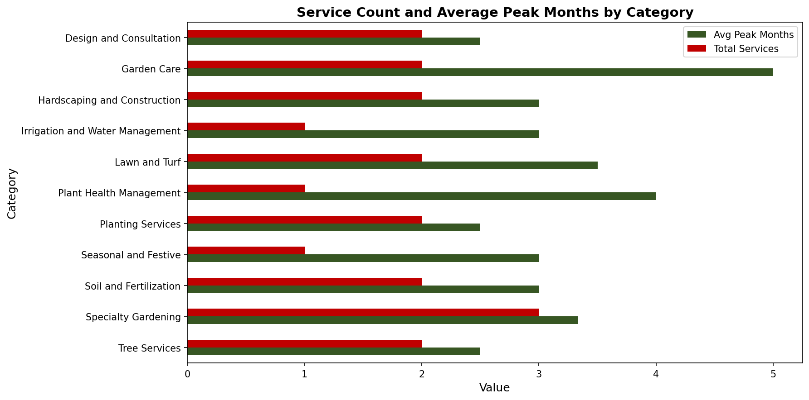
Service Count and Average Peak Months by Category
Description: This chart shows how many services exist per category and how many months, on average, each experiences peak demand.
Insight: Some categories sustain demand for months at a time, while others see short, sharp seasonal spikes.

Slide 11
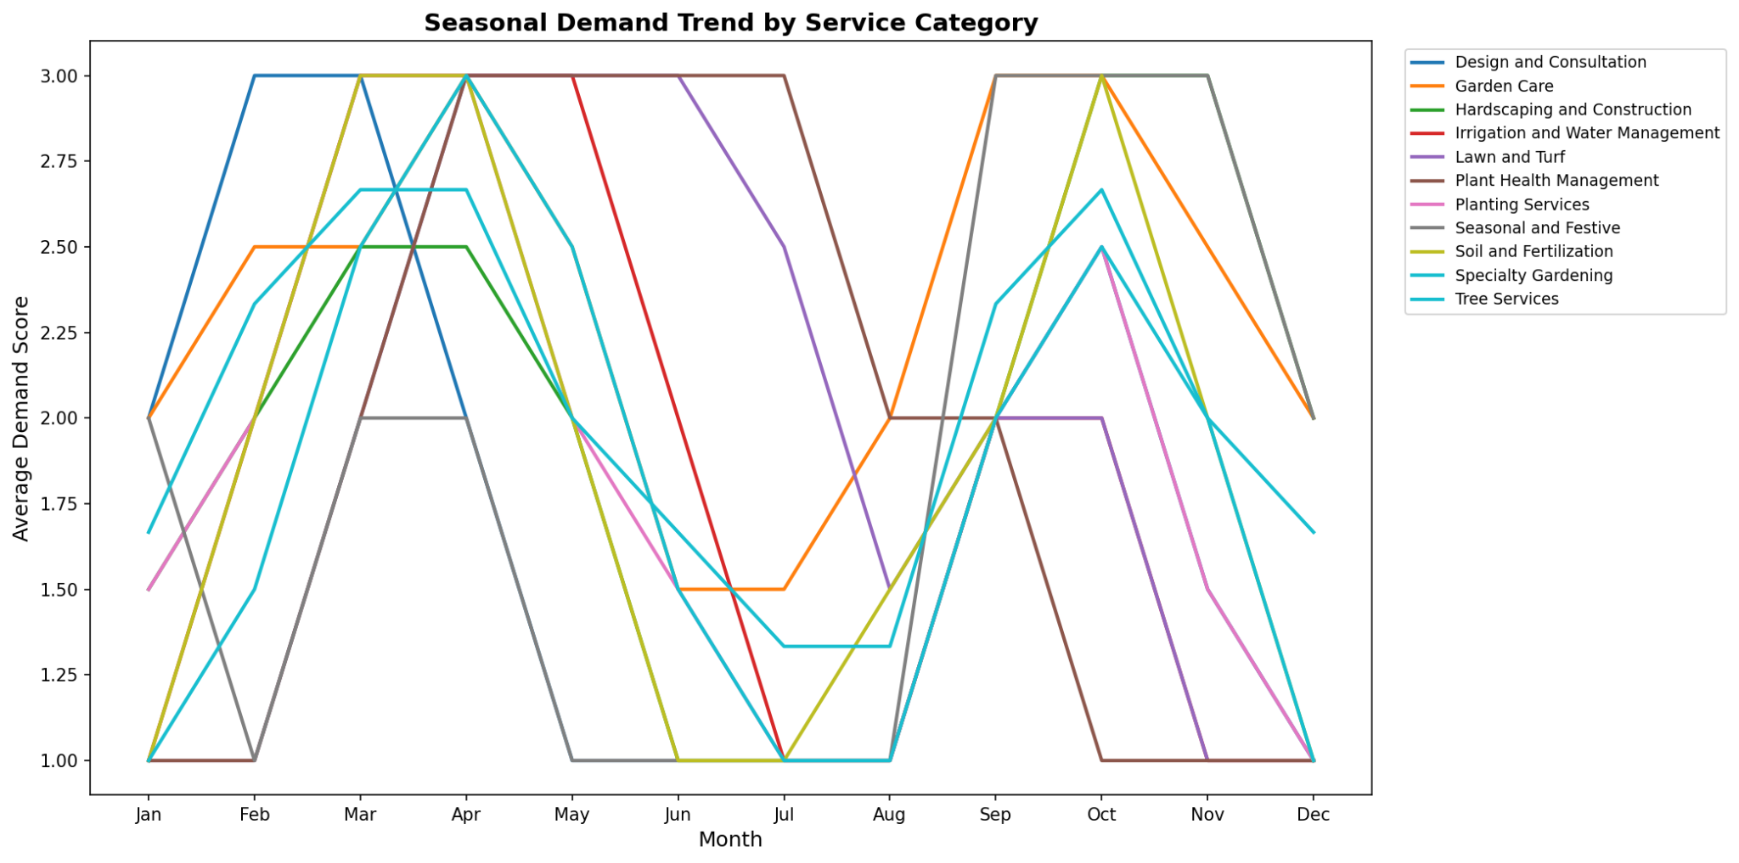
Seasonal Demand Trend by Service Category
Description: This chart tracks the average demand score trend over the year for each service category.
Insight: Different categories peak at different times of year, showing that seasonality varies significantly by service type.

Slide 12
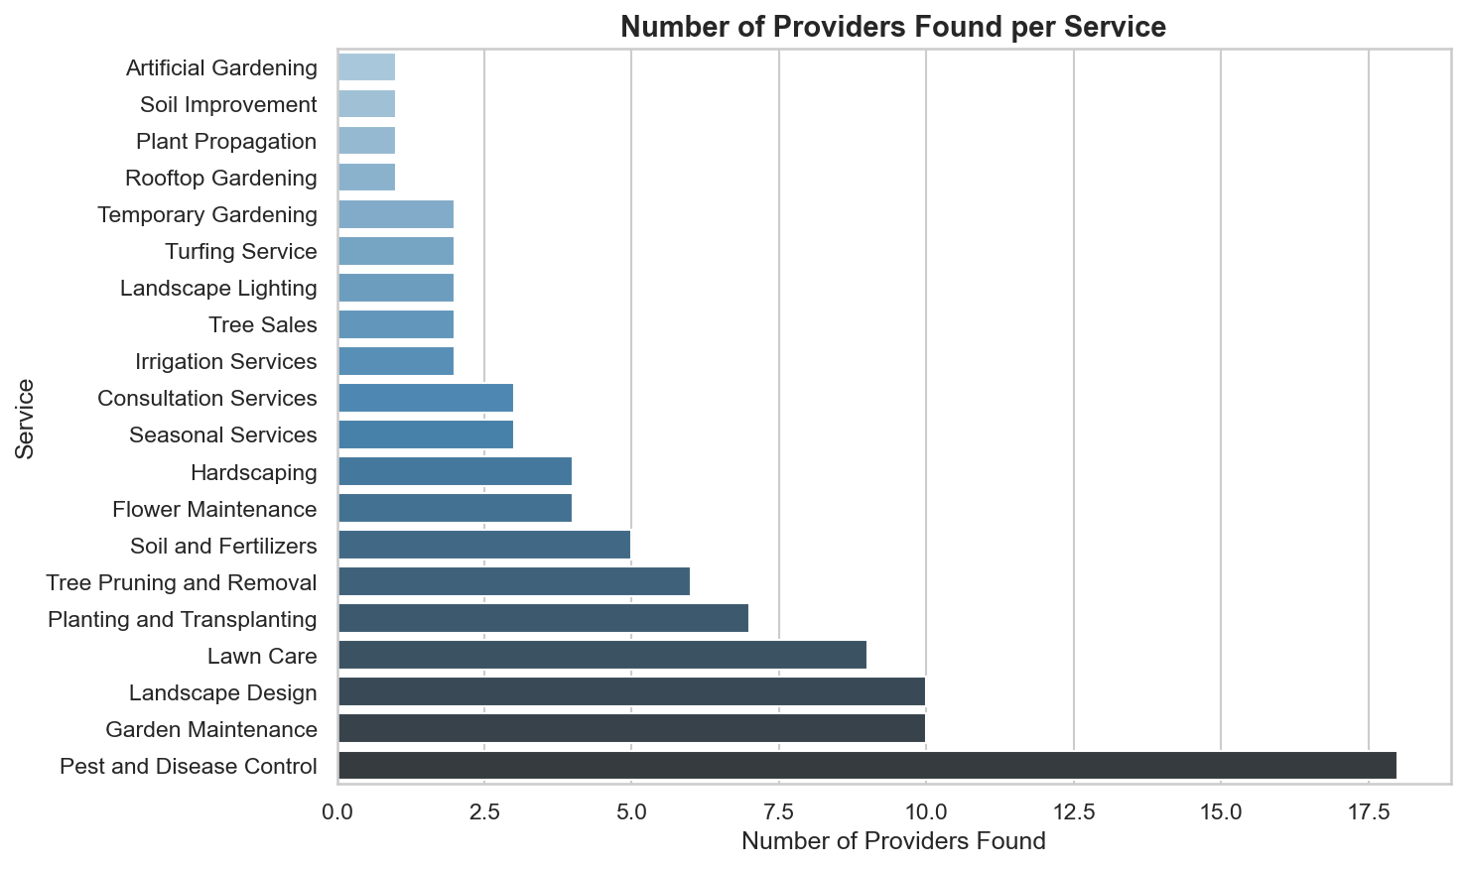
Number of Providers Found per Service
Description: This chart shows how many providers were identified for each of the 20 services.
Insight: Provider supply drops off sharply after the top few services, showing a long tail of under-served services.

Slide 13
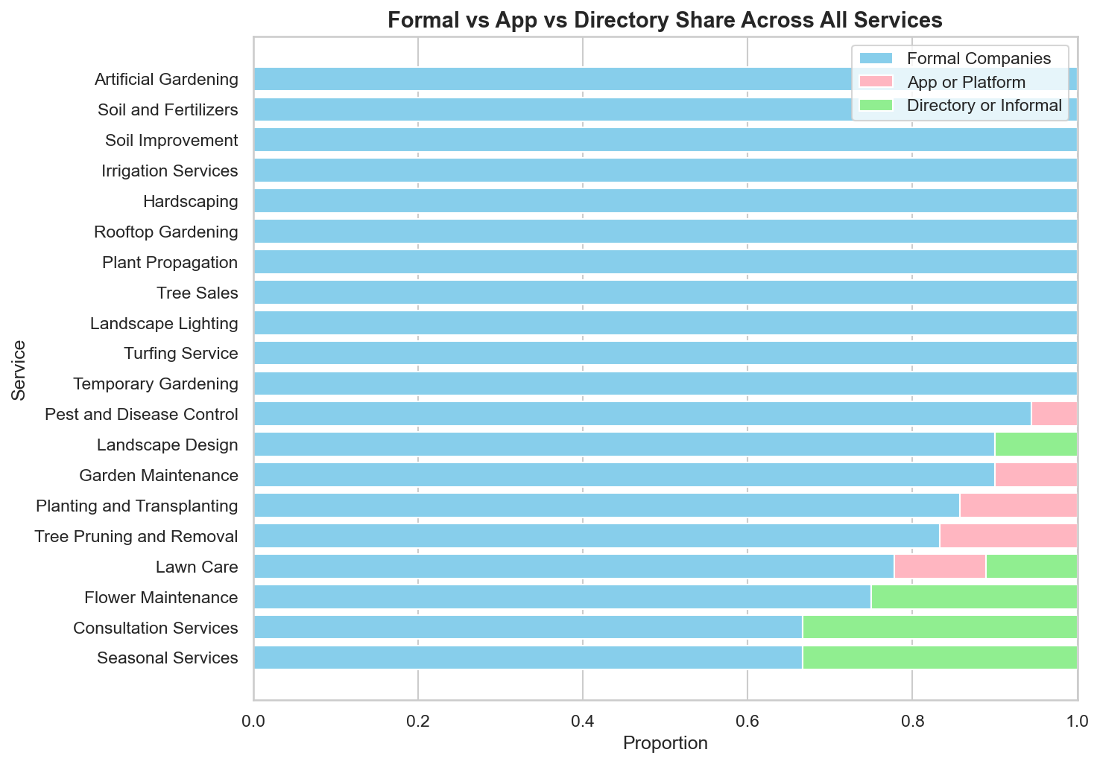
Formal vs App vs Directory Share Across All Services
Description: This chart shows the mix of formal companies, app-based providers, and informal/directory listings within each service.
Insight: Formal companies are present in every service, while app and informal providers appear only in select categories.

Slide 14
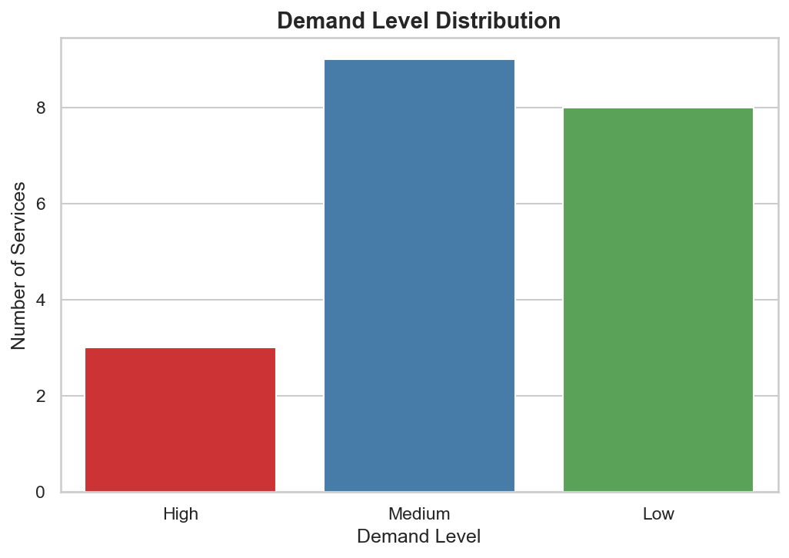
Demand Level Distribution
Description: This chart groups all 20 services into High, Medium, or Low demand categories.
Insight: Only a few core upkeep services rate High demand, with most services falling into the Medium or Low tier.

Slide 15
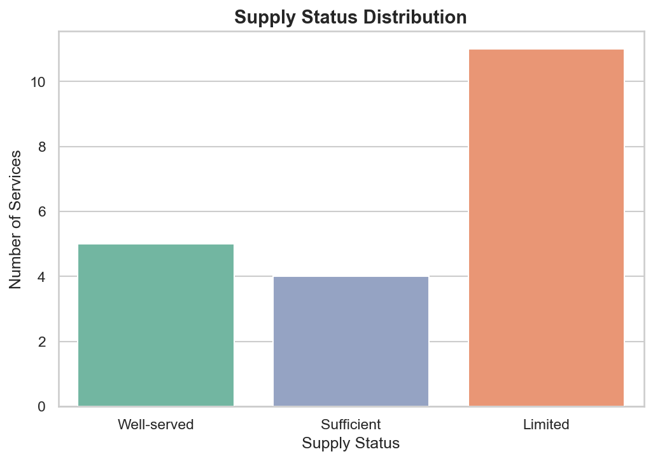
Supply Status Distribution
Description: This chart classifies services by how well their current provider supply meets demand.
Insight: Over half of all services fall into “Limited” supply, pointing to a clear gap between demand and provider availability.

Slide 16
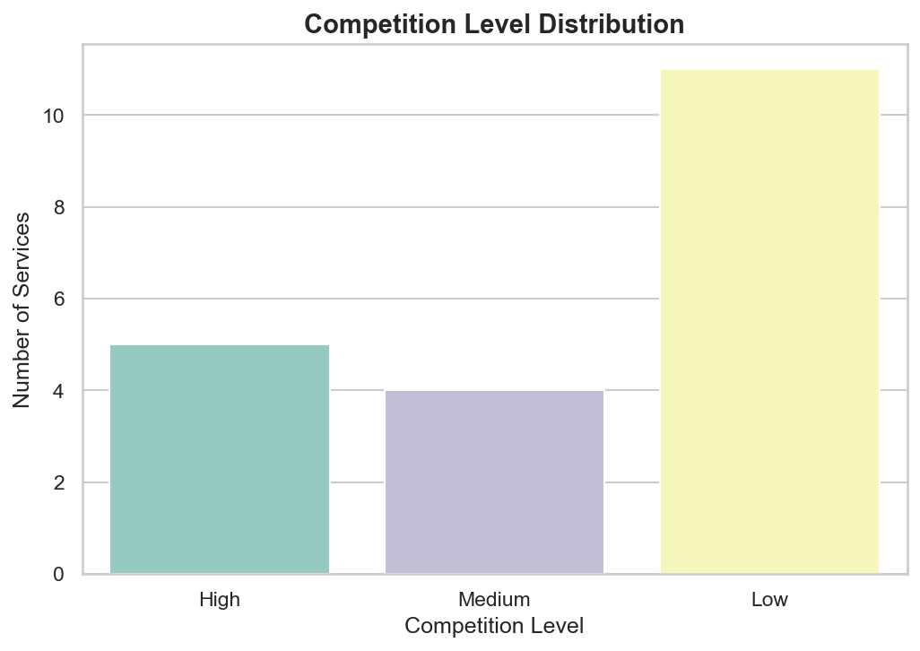
Competition Level Distribution
Description: This chart groups services by their level of competition among existing providers.
Insight: Most services face Low competition, suggesting room for new entrants across much of the catalog.

Slide 17
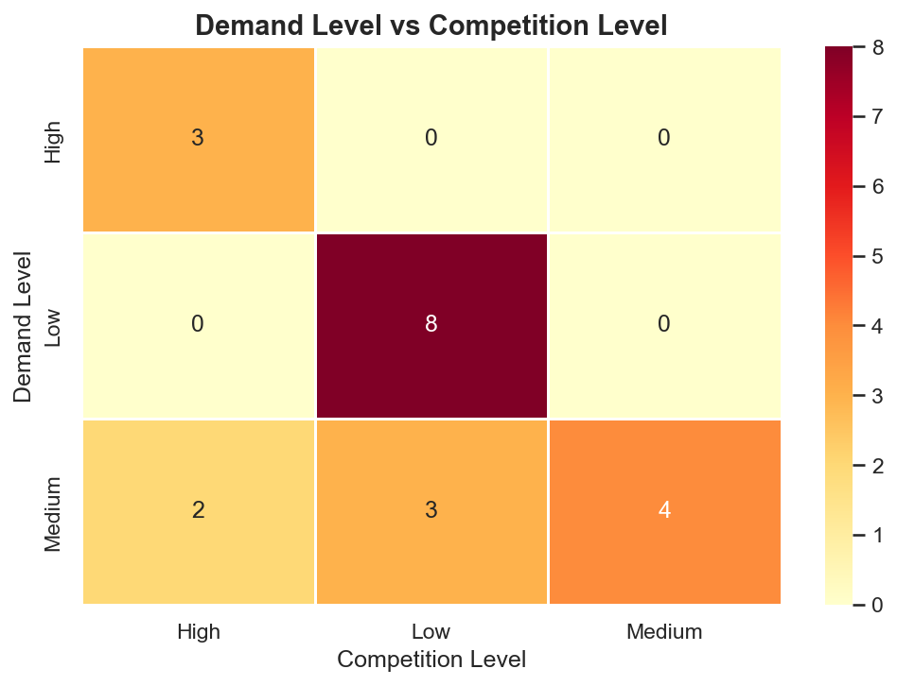
Demand Level vs Competition Level
Description: This chart cross-tabulates demand level against competition level to spot where demand outpaces competition.
Insight: High-demand services consistently also faces High competition, while Medium-demand services show the most varied pattern.

Slide 18
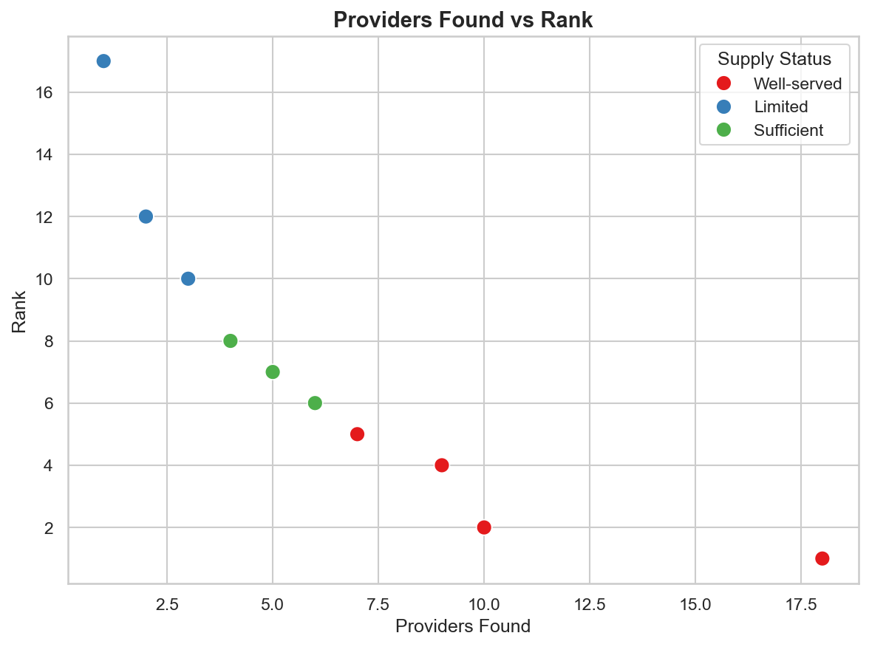
Providers Found vs Rank
Description: This chart plots the number of providers found for each service against its supply-status ranking.
Insight: Services with fewer providers consistently rank lower on supply status, confirming that supply gaps are provider-driven.

Slide 19
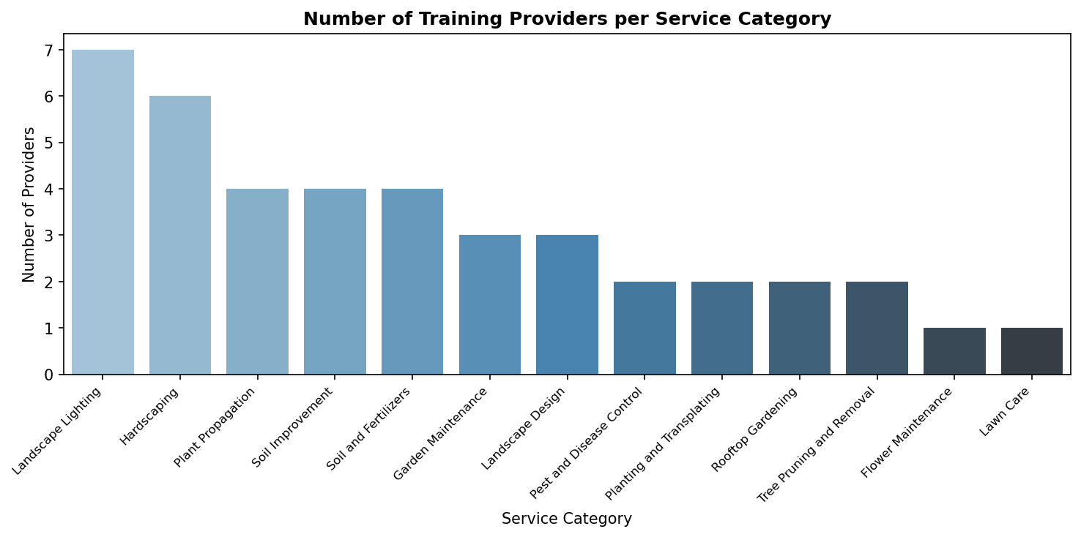
Number of Training Providers per Service Category
Description: This chart shows how many training providers exist for each service category.
Insight: Training availability is concentrated in a few popular categories, leaving others with very limited options.

Slide 20
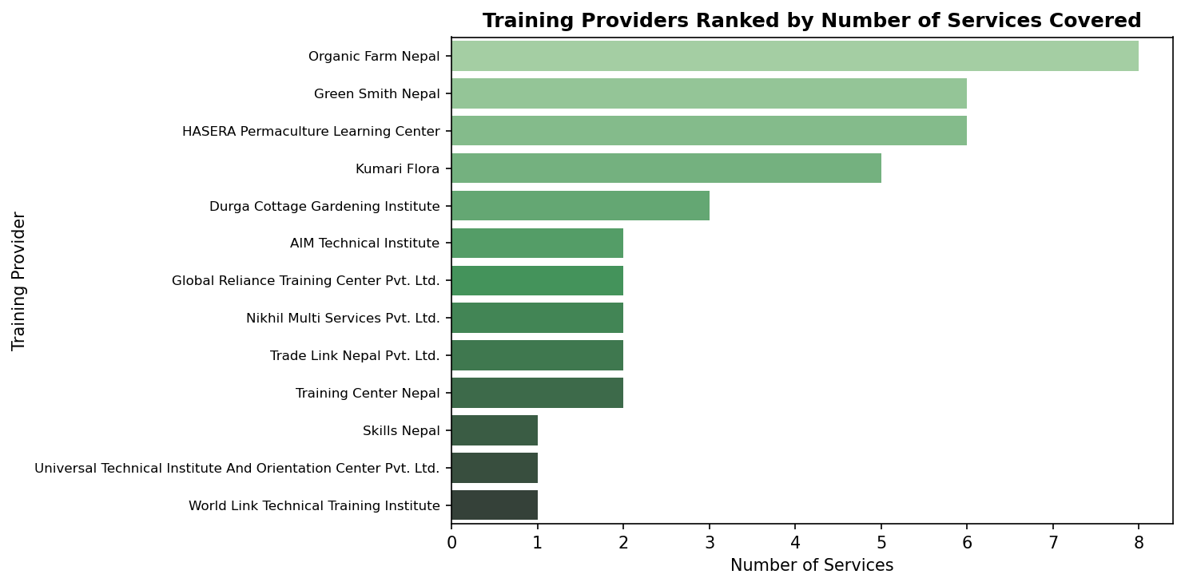
Training Providers Ranked by Number of Services Covered
Description: This chart ranks training institutions by how many different services they provide training for.
Insight: A small set of anchor institutions cover most trainable services, while most providers specialize narrowly.

Slide 21
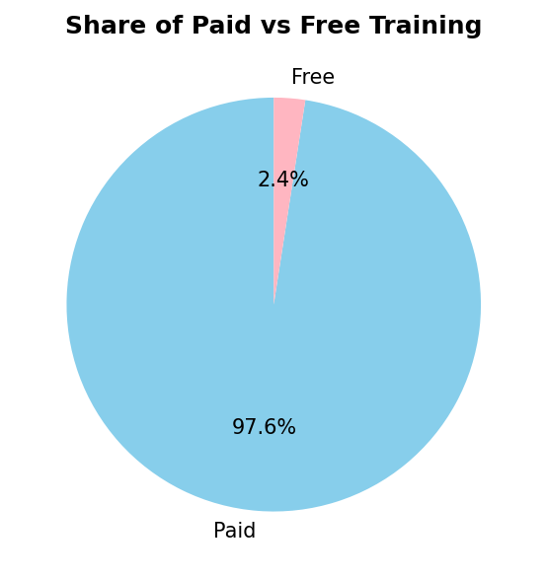
Share of Paid vs Free Training
Description: This chart shows what proportion of training programs are paid versus free.
Insight: Training is almost entirely paid, with free options essentially unavailable across the catalog.

Slide 22
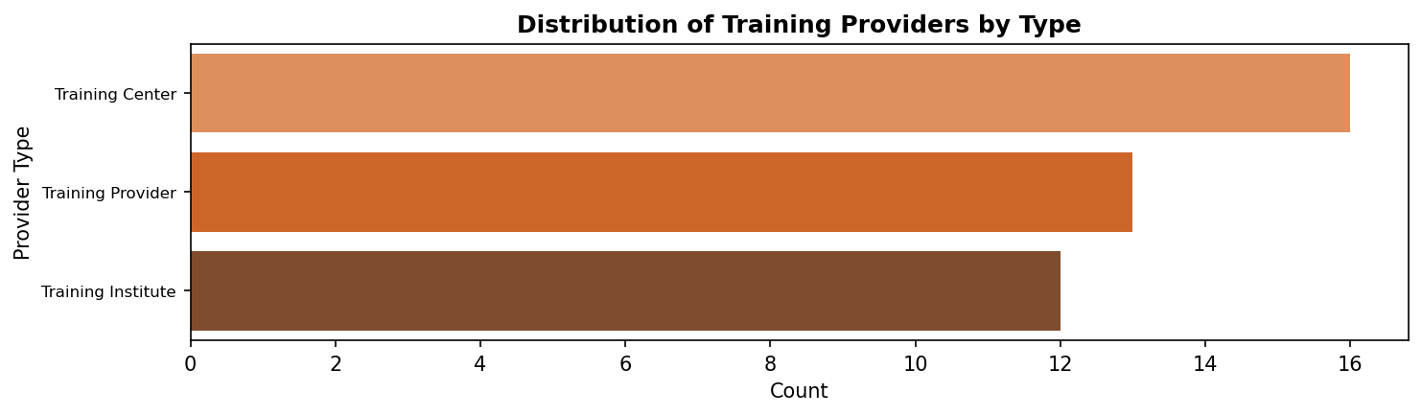
Distribution of Training Providers by Type
Description: This chart breaks down training providers by type, such as Training Center, Training Provider, or Training Institute.
Insight: Training Providers are fairly evenly split across the three provider types, unlike a market dominated by one.

Slide 23
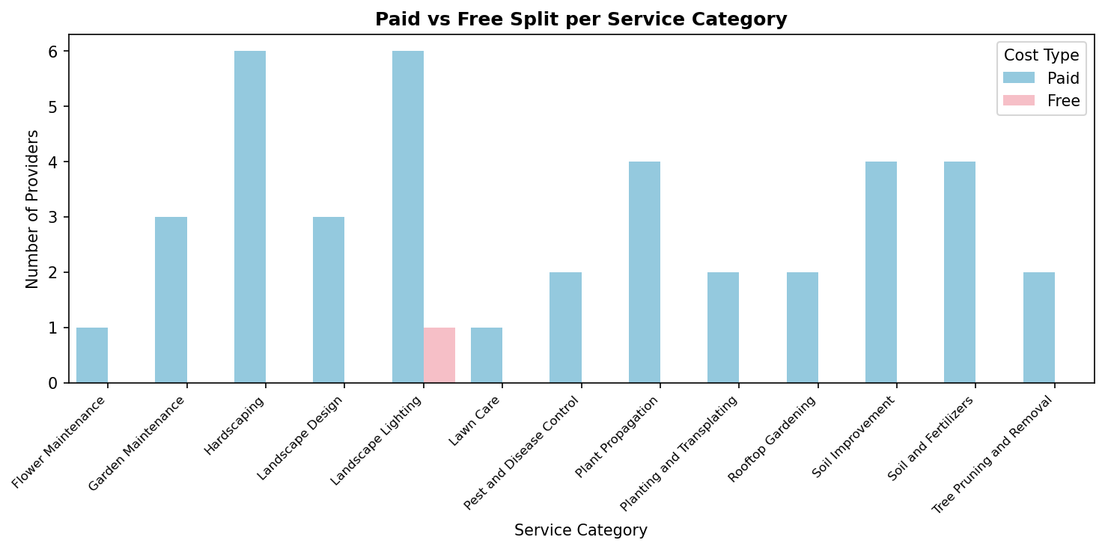
Paid vs Free Split per Service Category
Description: This chart shows the paid versus free training split within each individual service category.
Insight: Nearly every service category is dominated by paid training, with free options appearing in only one category.

Slide 24
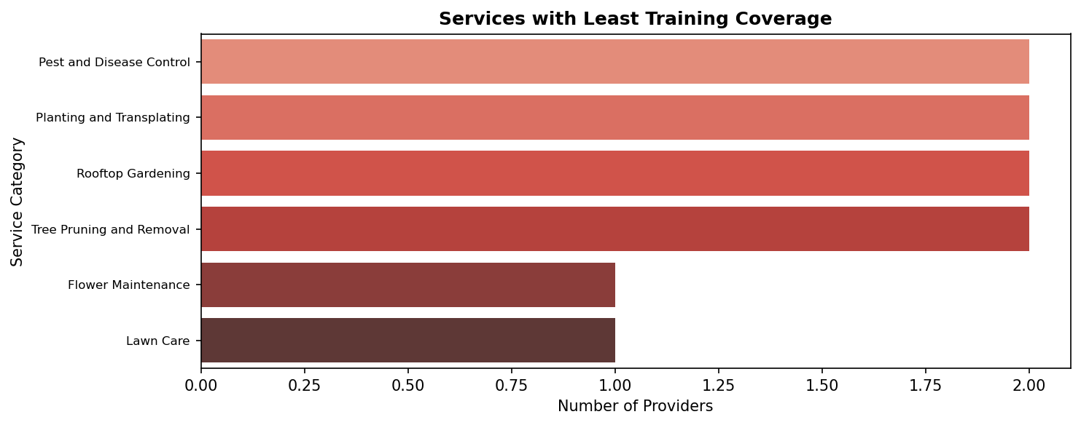
Services with Least Training Coverage
Description: This chart highlights the services with the fewest available training providers.
Insight: Several service categories show little to no training availability, signaling a clear skills-development gap.

Slide 25
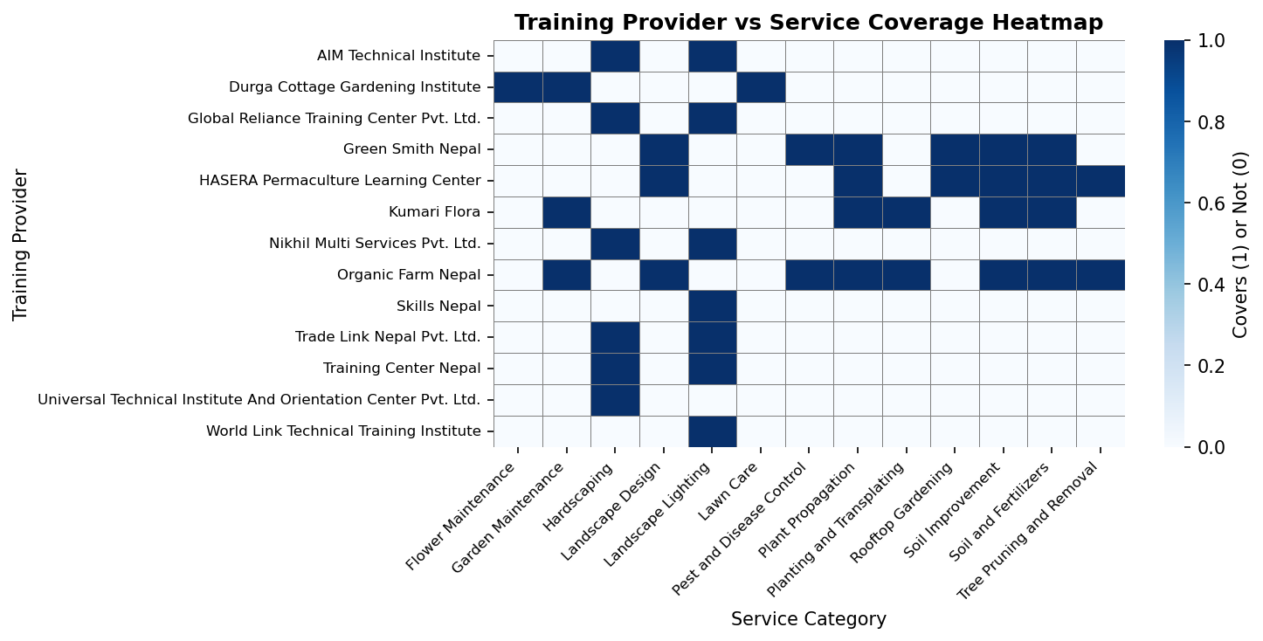
Training Provider vs Service Coverage Heatmap
Description: This heat map shows which training institutions offer training for which service categories.
Insight: No single provider covers the full service catalog, so partnering across multiple training institutions will be necessary.

Slide 26
Sources
Comparative Analysis: Google Search (official service provider websites)
Yearly Services: Analysis based on seasonal demand patterns
Workforce Analysis: Google Search (official service provider websites)
Training Providers: Google Search (official training provider websites)

Slide 27
Thank You

